Slide 1

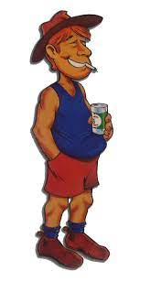


A
M
0
7
:
1
1
You need to be at work at 9!
Pub

Slide 2
A
M
0
7
:
1
1
You need to be at work at 9!
Time left to get to work
The Bogan, it could be a 50/50 chance in losing time or you could ge t
The Pub is a sanctuary if the player is chased by Eshays
Eshays will chase the player
The player running to the pub for safety
The Larrikin, he will help you get to work faster
Pub

